Slide 1
Networks and Positive Feedback
Byung Joon Yoo

Slide 2
Important Ideas
Positive feedback
Network effects
Returns to scale
  Demand side
  Supply side

Slide 3
Positive Feedback
Strong get stronger, weak get weaker
Negative feedback: stabilizing
Makes a market “tippy”
Examples: VHS v. Beta, Wintel v. Apple
“Winner take all markets”

Slide 4
Sources of Positive Feedback
Supply side economies of scale
  Declining average cost
  Marginal cost less than average cost
  Example: information goods
Demand side economies of scale
  Network effects
  In general: fax, email, Web
  In particular: Sony vs. Beta, Wintel vs. Apple

Slide 5
Network Effects
Real networks: Phone
Virtual networks: User group
Number of users
  Metcalfe’s Law (Ethernet):
  Value of network of size n proportional to n²
Importance of expectations

Slide 6
Lock-In and Switching Costs
Network effects lead to substantial collective switching costs
Even worse than individual lock-in
Due to coordination costs
Example: QWERTY

Slide 7
Don’t Get Carried Away
Network externalities don’t always apply
  ISPs (but watch out for QoS(Video conferencing) in the future)
  PC production (IBM Compatible)
  Adopters, Standard
Likelihood of tipping
  See next slide

Slide 8
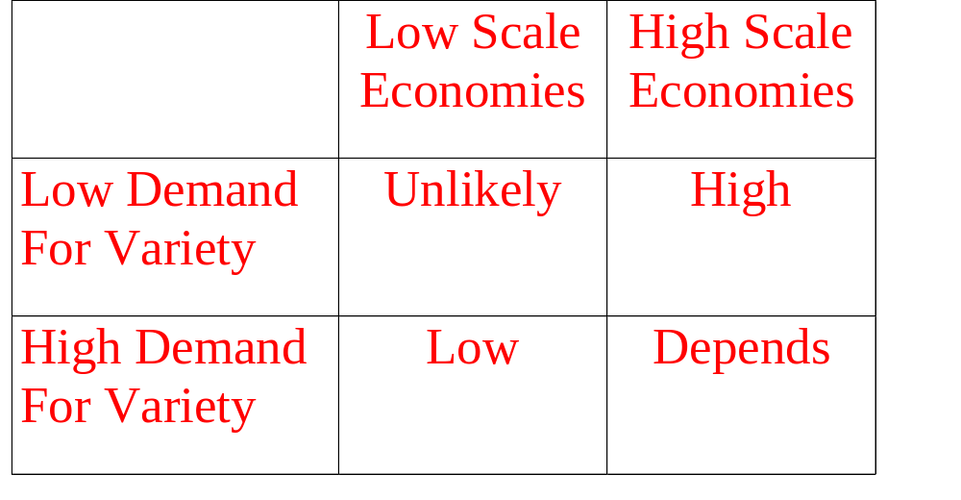
Likelihood of Tipping

Slide 9
Chicken & Eggs
Fax and fax machines
VCRs and tapes
Internet browsers and Java
(Internet can reduce this problem to some what extent by reducing switching costs)

Slide 10
Igniting Positive Feedback
Strategy 1: Evolution
  Give up some performance to ensure compatibility, thus easing consumer adoption
Strategy 2: Revolution
  Wipe the slate clean and come up with the best product possible

Slide 11
Evolution
Offer a migration path
Examples
  Color TV-CBS system failed-BW TV
  Microsoft-Support for WordPerfect users
  Borland vs. Lotus
Build new network by links to old one
Risk: Competitors’ revolution strategy
Problems: technical and legal obstacles

Slide 12
Technical Obstacles
Need to build better but compatible technology (backward compatibility)
  One-way compatibility (MS Word 97 – Resistance)
Use Creative design-NBC compatible color TV signal
Think in terms of system-Extra spectrum for HDTV & Conventional signal
Converters and bridge technologies
  HDTV Converter to solve compatibility problem

Slide 13
Legal Obstacles
Legal and contractual obstacle
Example: Sony and Philips CDs in US

Slide 14
Revolution
Offer a product so much better than current products to overcome pains of switching to it
Andy Groves’s law: “10X rule”
But depends on switching costs
Example: Sega vs. Nintendo

Slide 15
Openness v. Control
(Trade-Off)
Your reward = Total added to industry x your share
Value added to industry
  Depends on product and
  Size of network
Your share
  Depends on how open
  (Figure 7.5)
Optimal may be a hybrid strategy: Intel’s MMX vs. AGP

Slide 16
Openness
Full openness
  Anybody can make the product
  Problem: no champion
Alliance
  Only members of alliance can use
  Problem: holding alliance together

Slide 17
Control
Control standard and go it alone
If several try this strategy, may lead to standards wars

Slide 18
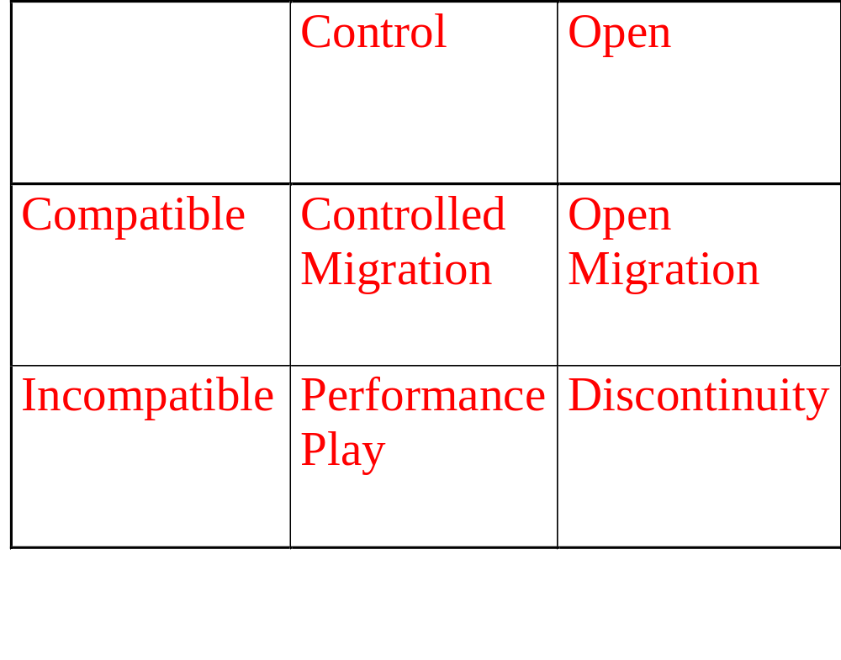
Generic Strategies

Slide 19
Performance Play
Introduce new, incompatible technology
Examples
  Palm Pilot
  Iomega Zip
Attractive if
  Great technology
  Outsider with no installed base

Slide 20
Controlled Migration
Compatible, but proprietary (with their current versions)
Examples
  Windows 98
  Pentium
  Upgrades
Dynamic form of versioning strategy (First adopters, then general consumer group)

Slide 21
Open Migration
Many vendors, compatible technology
Examples
  Fax machines
  Some modems
  HP
When the advantage is from the scale of economics

Slide 22
Discontinuity
Many vendors, new technology
Examples
  CD audio
  3 1/2” disks

Slide 23
Historical Examples of
Positive Feedback
Rail Road gauge: Mostly good for society but individual incentives to diverge (Hitler, South at Civil war)
Lessons
  Incompatibility arised by accident but persist (Rail Road gauges)
  Tippy market again
  Those left may use adapters or join the bandwagon
  Superior tech can overcome first mover advantage (AC vs. DC)
  Open but control key factors with your own term (Bell system-open but restrict and kick out local competitors)
  Importance of compatibility and complementary goods (Color TV)
  Leapfrogging and alliances (Japan vs. US HDTV case), and Support by Dual mode policy (FCC HDTV)

Slide 24
Lessons
Positive feedback means strong get stronger and weak get weaker
Consumers value size of network
Works for large networks, against small ones
Consumer expectations are critical
Fundamental tradeoff: performance and compatibility

Slide 25
Lessons, continued
Fundamental tradeoff: openness and control (Optimal level?)
Generic strategies
  Performance play
  Controlled Migration
  Open Migration
  Discontinuity
Lessons of history

Slide 26
Next Session
Information Rules: Ch.8 Cooperation and Compatibility, Ch.9 Standard War
EC: Ch. 9 Online Media
Cases

